Slide 1

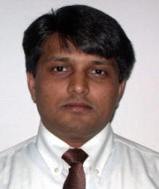
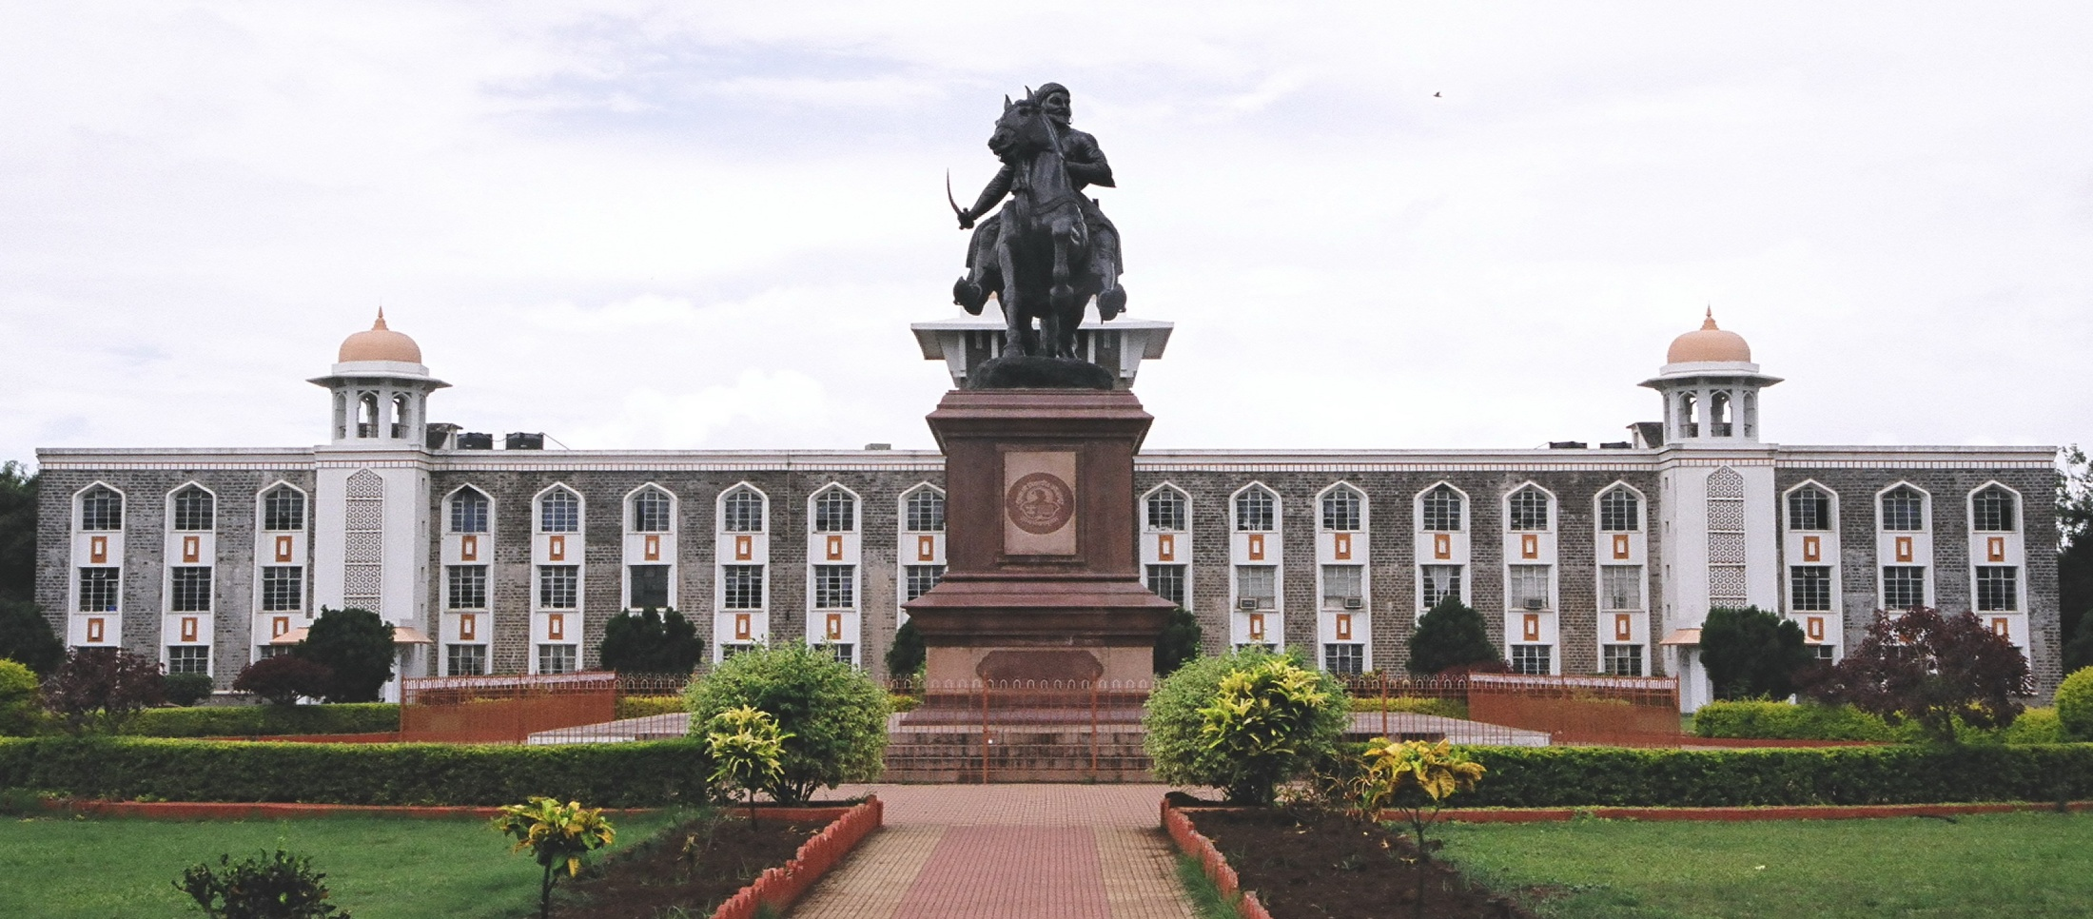
Green Chemistry Weds Nanotechnology : Sustainable Green Nanotechnology
Prof. (Dr.) Anil Vithal Ghule (M.Sc., Ph. D., L.L.B., L.L.M.)
Department of Chemistry, Shivaji University Kolhapur 416004, Maharashtra, India
E-mail: avg_chem@unishivaji.ac.in; Mob: +91-9145772101
Prof. Anil Ghule received his B.Sc. (Chemistry), B.Sc. (Botany), M.Sc. (Chemistry, Dept of Chemistry) from the University of Pune, Pune and Ph.D. from National Tsing Hua University, Hsinchu, Taiwan. He received his L.L.B. and L.L.M. (Law) degrees from Dr. Babasaheb Ambedkar Marathwada University, Aurangabad, India with core interest in Intellectual Property Rights (IPR). He is currently a Professor of Chemistry (Analytical-Industrial Chemistry), Department of Chemistry, Shivaji University, Kolhapur (SUK), India, Director, International Affairs Cell and Director, Intellectual Property Rights, Shivaji University, Kolhapur. Before joining SUK, he was working as Assistant Professor, Department of Nanotechnology, Dr. Babasaheb Ambedkar Marathwada University, Aurangabad, India. He has good international collaborations and had worked at Hanyang University, Korea as BK21 Fellow, Nevada Nanotechnology Centre, UNLV, Nevada, Las Vegas, US Fellowship and National Tsing Hua University, Hsinchu, Taiwan as Research Associate with NSC Fellowship. He had also served as the President of the Foreign Students Association and as a member of several professional bodies.
Prof. Ghule has twenty years of multidisciplinary research experience and had worked on several interdisciplinary projects with the opportunity to explore several states of art analysis tools. His research interests are mostly focused on developing novel materials and devices using Greener approaches. Some of his interests are developing room-temperature operated efficient gas sensors, solar cells, Li-batteries, supercapacitors, materials for energy, environmental, technological and biomedical applications, most in which he probes for greener elements. He has published more than 150 research papers, participated in 30+ conferences and chaired 30+ conferences. He had delivered 160+ invited talks covering the range of his research work. His present citations are 4228, h-index is 36 and the i-10 index is 100.

